Slide 1

Unconventional Automation
Matt Perrin
CodeMash 2017

Slide 2


Slide 3


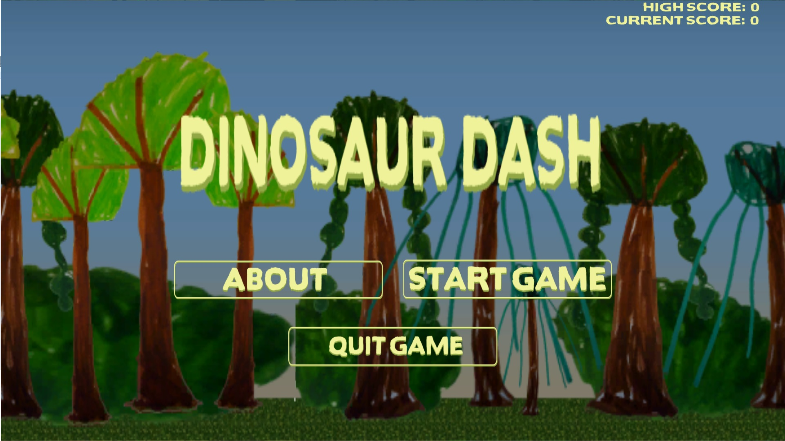

Hello!
System Test Engineer Lead
Progressive Insurance (Mayfield Village, Ohio)
Hybrid Developer / QA
Create tools and processes to solve testing challenges
Previous work…
Telecom software
Voice over IP
Cleveland Game Developers Organizer
Maker, developer, experimenter

Slide 4
Session Goals – Concepts & Ideas
Raise the value of what UI test automation (WebDriver) can provide by creating unique scenarios.
Leveraging Testability to discover failures points and explore them.
Test for the unexpected, or the unintended.

Slide 5
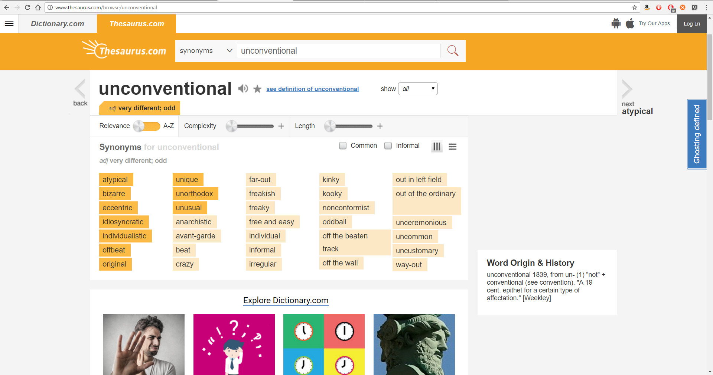

Slide 6
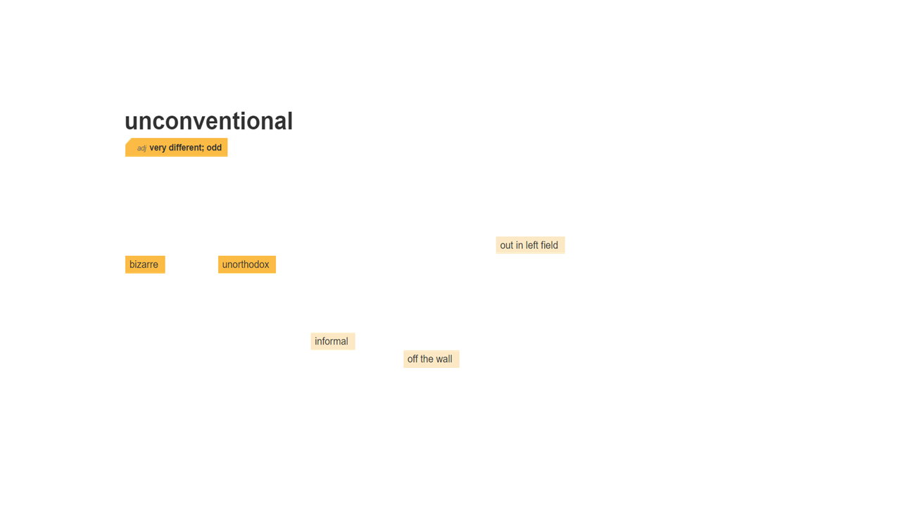

Slide 7
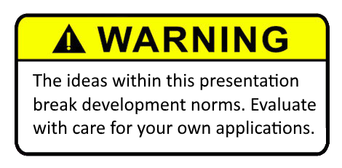

Slide 8


Slide 9
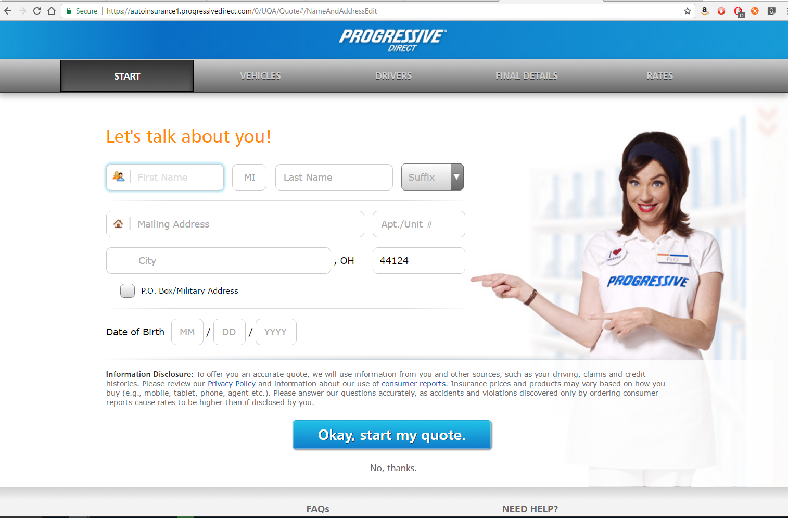

Slide 10
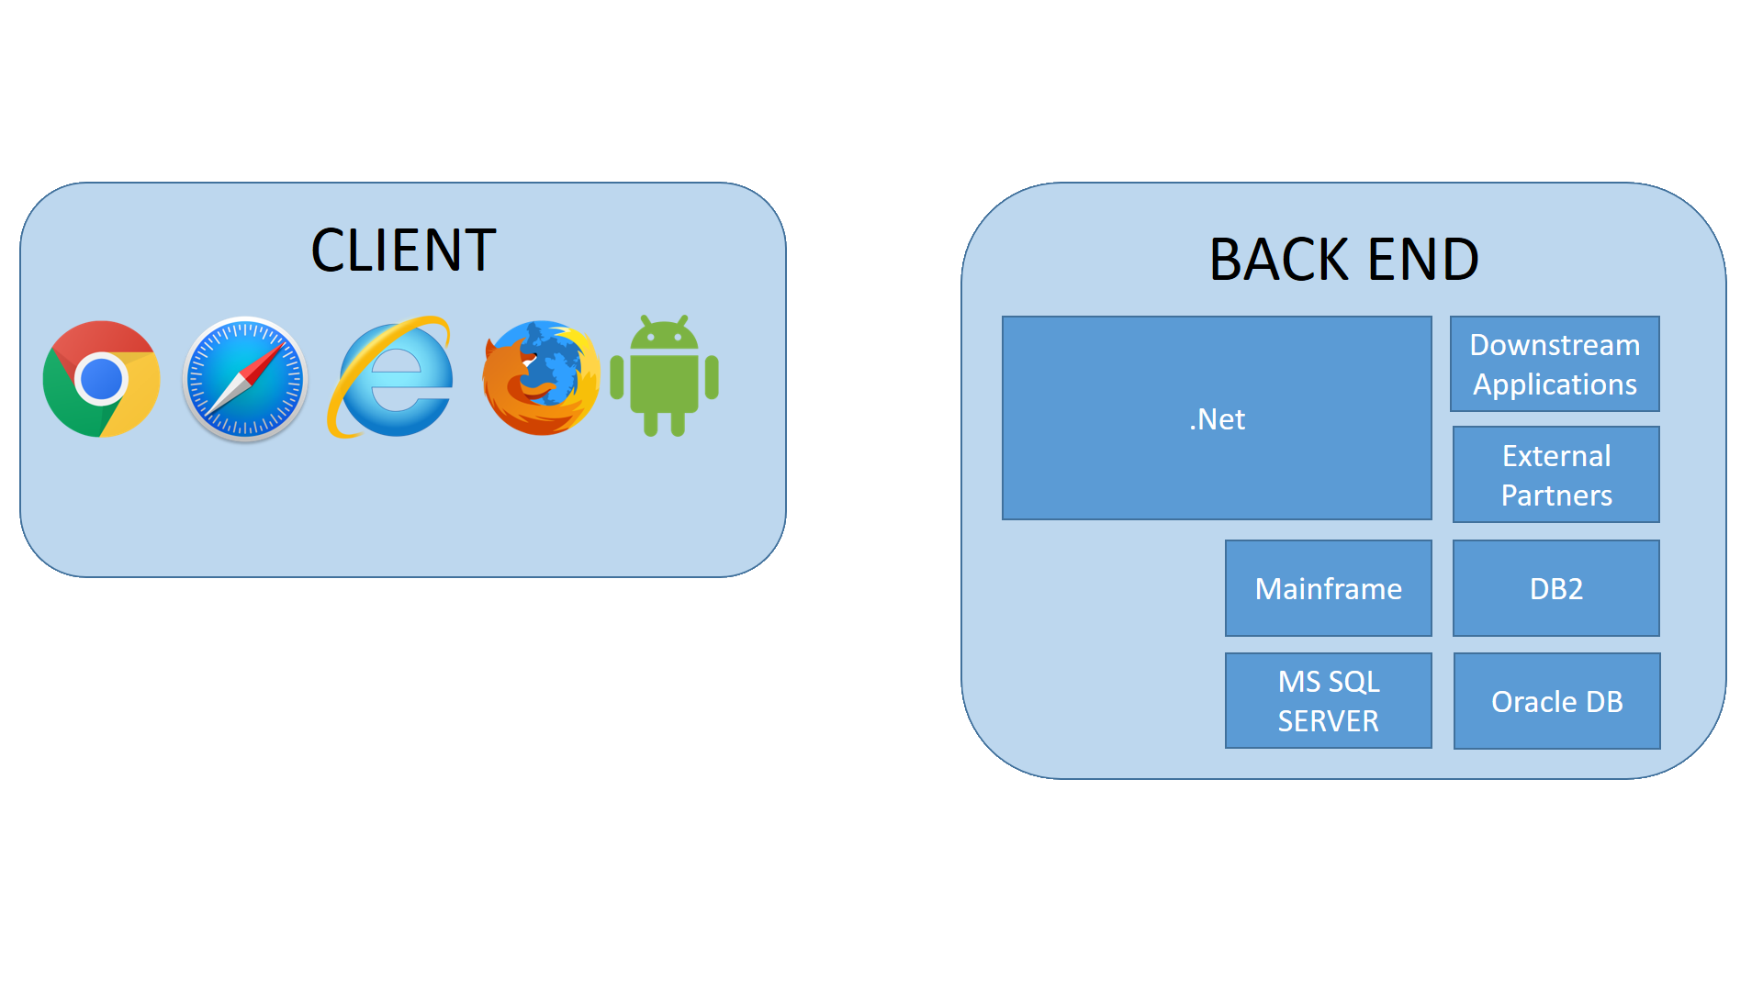
The System Under Test

Slide 11
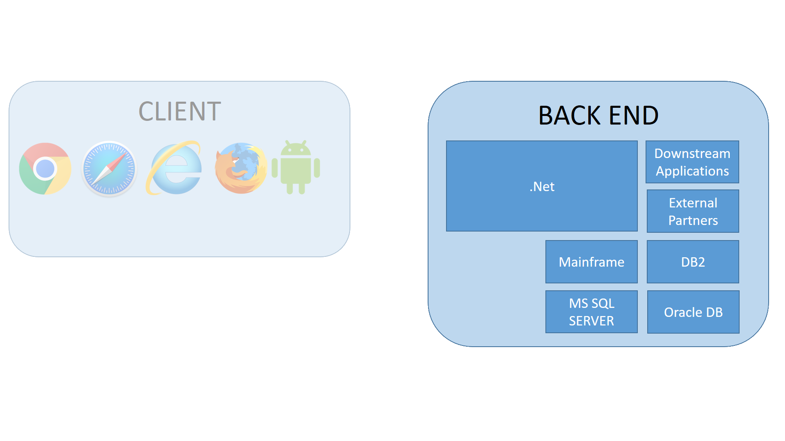
The System Under Test
Built upon a variety of technologies
Internal and external dependencies

Slide 12
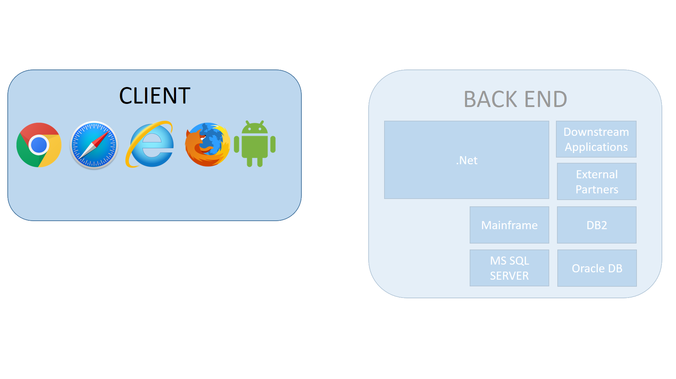
The System Under Test
Angular, JQuery, custom
Modern & Mobile Browsers
Performs some error mitigation.
*Not necessarily a good thing…

Slide 13


WebDriver Wrapper (C#)
C# Test Methods (VSTest.Console)
TRX
(Test Result XML)
Test Result Server

Slide 14
Test Instance
Page Object XML
Page
URL – “/pageurlhere”
Element
CSS Selector
Default Value
Step Order
Methods
Arguments
Step Order, Getter / Setter
Given…
Load Page Objects
When…
Reach specific page or test condition
System Under Test
Then…
Perform our meaningful / desired testing
TRX
(Test Result XML)

Slide 15
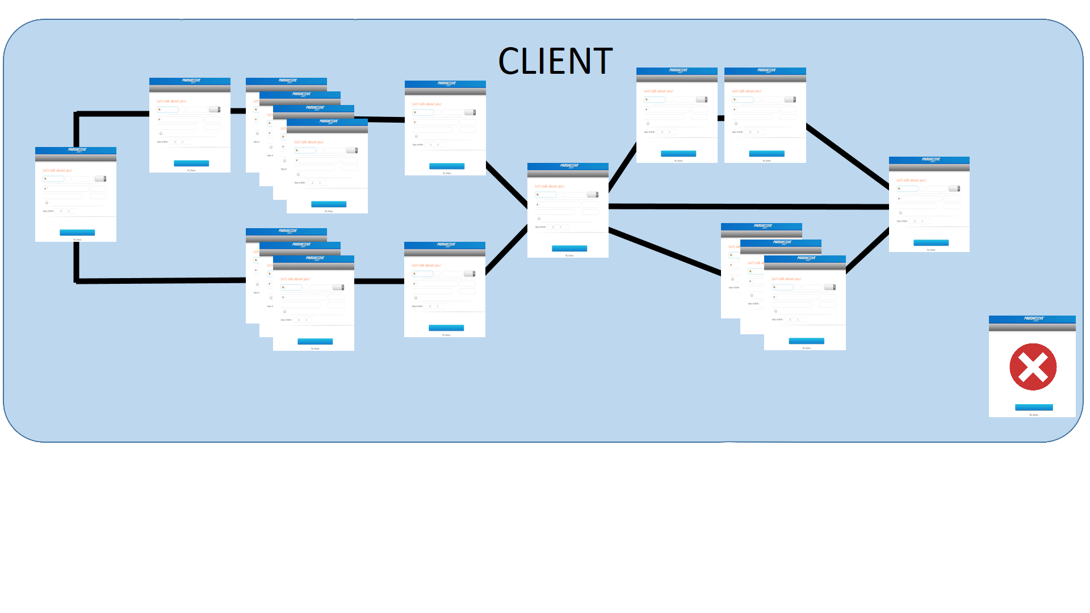
Customer experience is a branching flow…
Average of 20 individual web pages within a flow…
Over 20 auxiliary pages…

Slide 16

Application flow will change based on cookies or third-party data vendors.

Slide 17
User decisions can wildly variate the number and types of pages presented in the flow.

Slide 18
A/B feature tests may influence application behavior and flow.

Slide 19
Page flow changes due to state specific legal requirements.

Slide 20
Page flows route through to singular points.
These can act as goals

Slide 21
A confirmation page brings all of the application flows together.

Slide 22
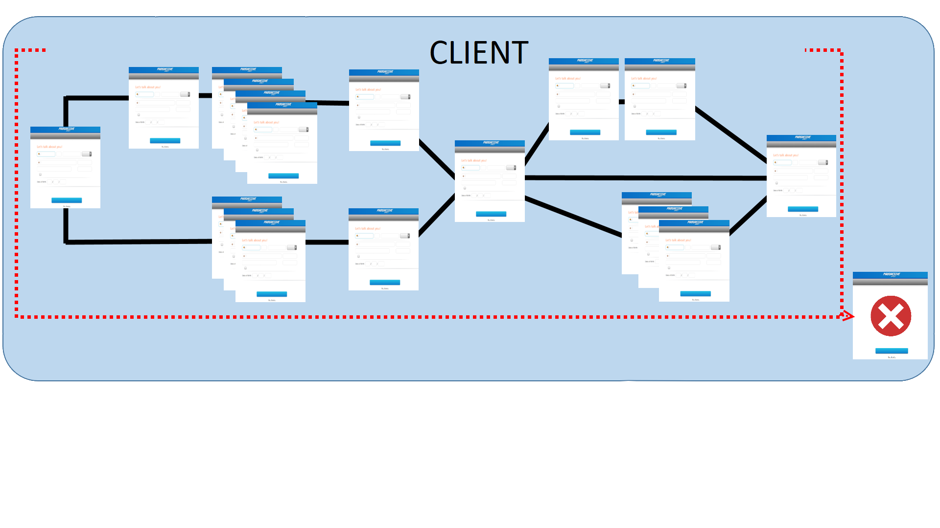
Severe errors within the applications redirect the browser to specific web pages.

Slide 23
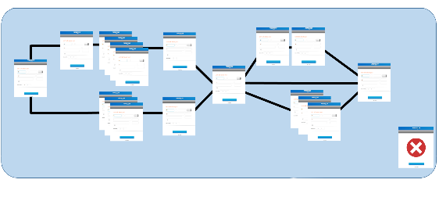
Support 50 state flows, plus Washington D.C.
Variations in field across the different flows.
Mailing Address vs. Street Address

Slide 24
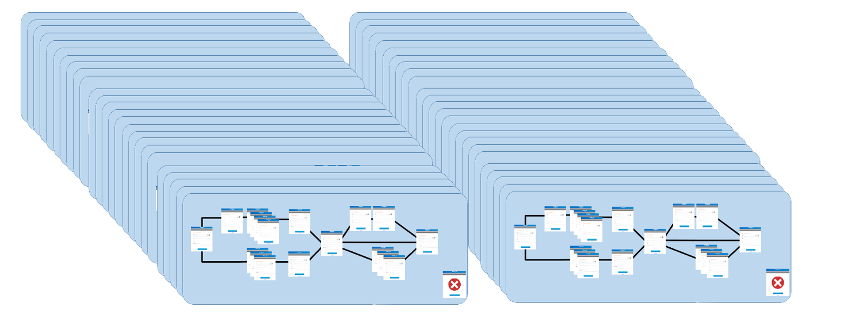
Over 100 active code branches at a time…
Multiple teams actively expanding the test base…
Others enhancing existing tests…
Rapid development projects that are not creating new tests.

Slide 26
Numbers, Because They Help Us Make Informed Decisions…
UI
API
Unit

Slide 27
Numbers, Because They Help Us Make Informed Decisions…
UI – 3000 Tests
API – 2000 Tests
Unit – 3000 Tests

Slide 28
The unquantifiable…
Calculating permutations for what could be the number of tests
300 Known Properties across 40+ pages…
51 Unique States…
30 Average Properties per Client flow…
… Carry the one…
… Divide by zero…

Slide 29
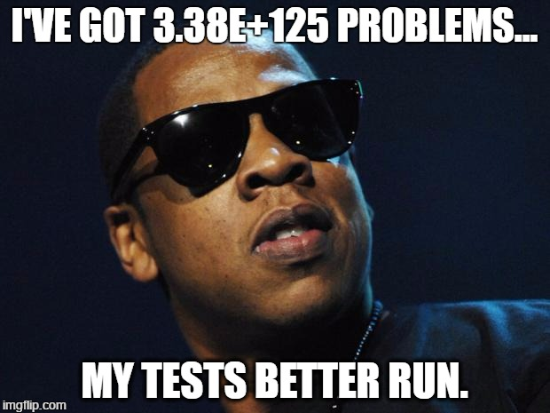

Slide 30
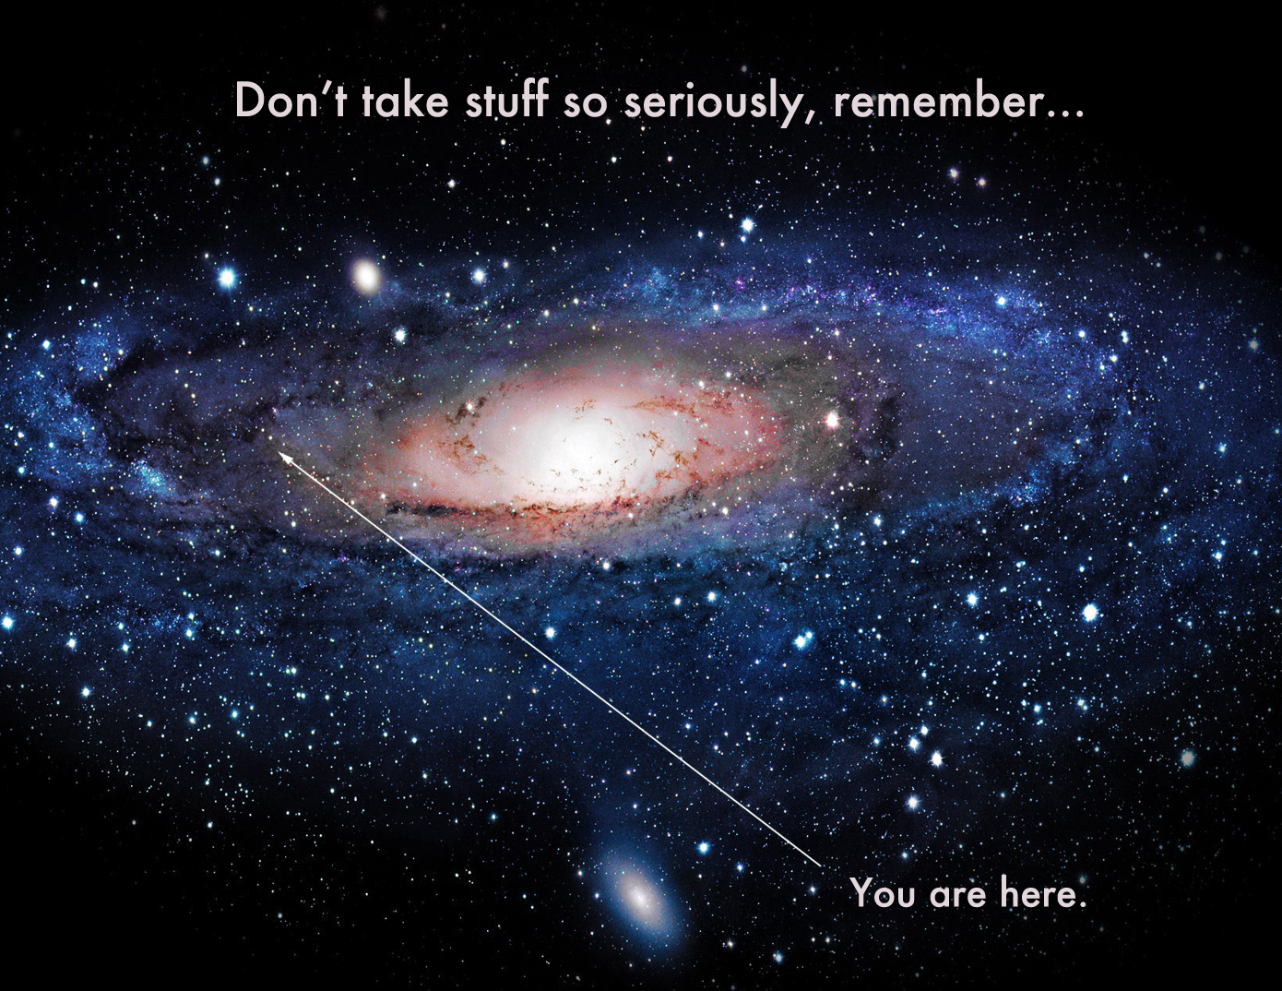

Slide 31



Slide 32
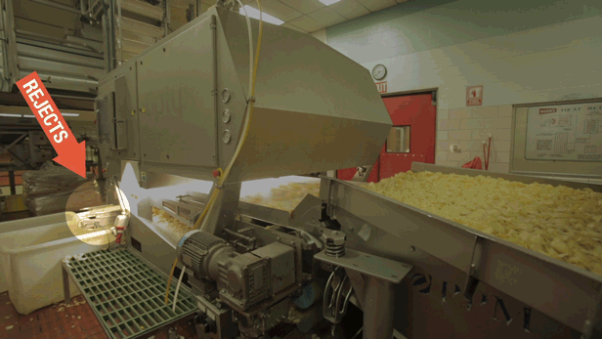

Slide 33
But what about the Passed tests…?
What do you do with all that data that’s been collected?
What information could be repurposed from those Passed tests?

Slide 34


Slide 35
Concept… Two “Bots”, Working Together
The Discovery Bot identifies testing opportunities…
The Exploratory Bot performs those tests…
You can’t explore a cave until it’s been discovered…
Reuses as much as possible..
WebDriver wrapper
Configuration
Existing data / page objects
Generate data, not test code itself.

Slide 36
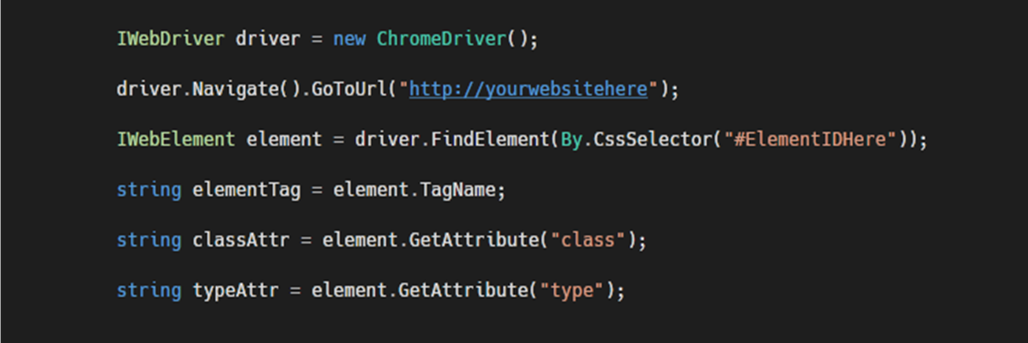

Slide 37
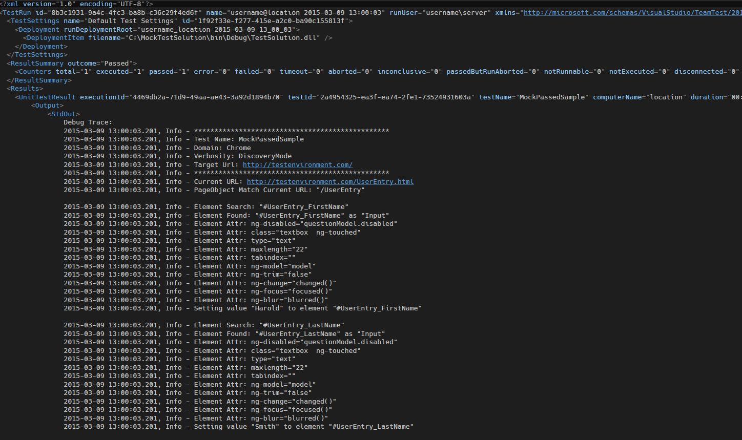

Slide 39
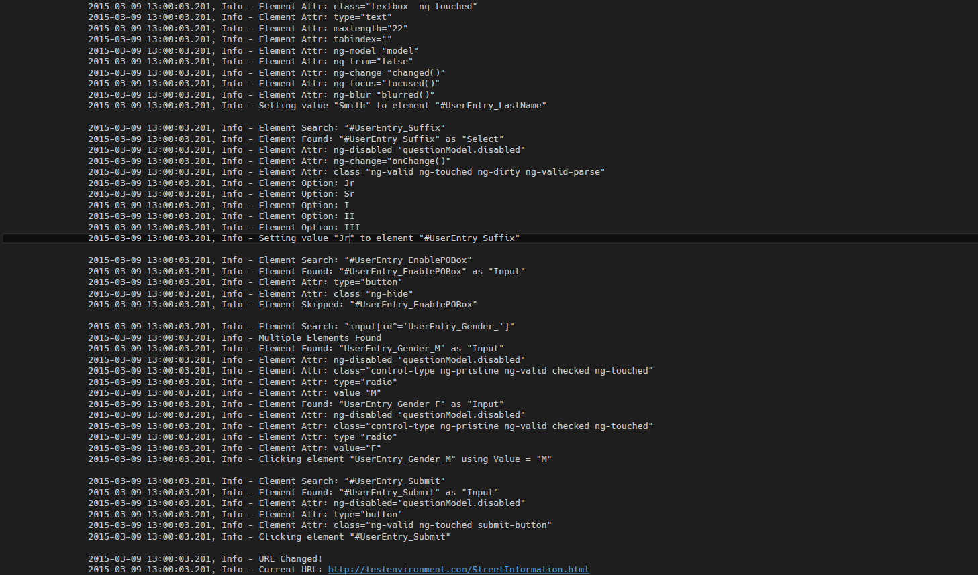

Slide 43
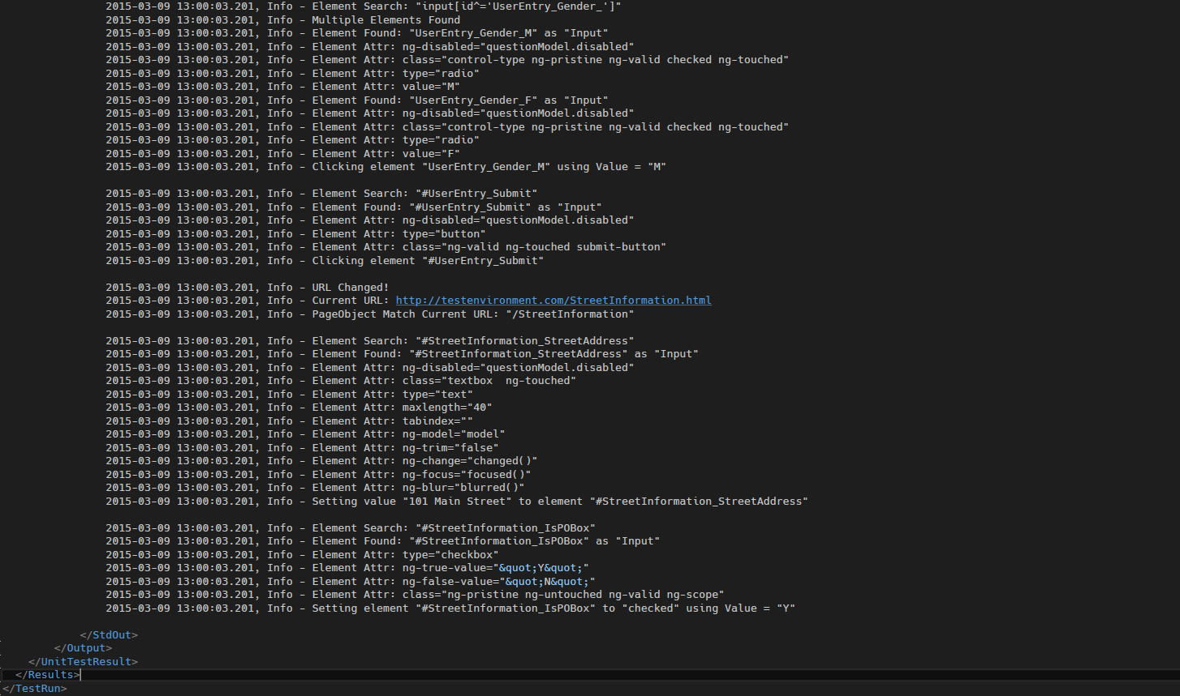

Slide 44
Assumptions
Development team has Testability in mind.
Elements are identifiable, with well-formed IDs or Patternable IDs
And have identifiable attributes
Type, Class, Value
Hidden
“Submit”
And because every app is different…
Selects contain Options
Radio and Checkbox have Values associated to them

Slide 45
Discovered elements…
#UserEntry_Firstname – Input
Type=text
#UserEntry_Lastname – Input
Type=text
#UserEntry_Suffix – Select
Options – “Jr”, “Sr”, “I”, “II”, “III”
#UserEntry_POBox – Input
Type=button, Class=ng-hide
Input[name=‘UserEntry_Gender’]
Type=radio, multiple element / values present
#UserEntry_Submit – Input – Type=text
Type=button, class includes ‘submit-button’
#StreetInformation_IsPOBox
Type=checked, values for True / False
Poor candidate, would not explore…
Poor candidate, would not explore…
Discovered Options for Exploration
Log within Hierarchy, but ignore…
Discovered related elements for Exploration
Discovered page transition for Exploration
Discovered Values for Exploration
Notes:
This gives us a tremendous amount of information to potentially act upon.

Slide 46
Hierarchy Example

Slide 47
Hierarchy Example

Slide 48
Generated Test Cases… (Raw Signatures)

Slide 49
Test Instance
Page Object XML
Signature Data
Page
URL – “/pageurlhere”
Element
CSS Selector
Default Value
Step Order
Methods
Arguments
Step Order, Getter / Setter
A.1.1
A.2.1
A.3.1
A.4.1
A.5.1
A.6.1
B.1.1
B.2.1
Given…
Load Page Objects
When…
Evaluate Goals on Element Interaction
System Under Test
Then…
Evaulate Goals on
Page Transition
TRX
(Test Result XML)

Slide 50
That’s great… but…where’s the value?
The Exploratory bot needs to have “Goals”
Reaching a specific page
Asserting a value meets a criteria check
Asserting a value fails a criteria check
Timeouts
“Passing” and “Failing” aren’t really the goals…
“What happened when I did “X”?
Check for Goal conditions on…
Before and after every Element operation
Every page transition

Slide 51
Goal: Compare the element value provided at one point, asserts as equal to the confirmation value.

Slide 52
Goal: Assert that a specific page is reached... Or Not reached.

Slide 53
What Can Be Discovered?
JavaScript performance metrics differing by state flows.
Data combinations affecting expected results.
Failure pages appearing unexpectedly.
Orphaned Elements.
Missing tests, redundant tests.

Slide 54


Slide 55
What Actually Influences Our Outcome…

Slide 56
What Actually Influenced Our Outcomes…

Slide 57
“Valuable” tests… (Exploratory Signatures)

Slide 58
One step further…
What would happen if you applied signature analysis within your existing / primary test suite?
Or compared it to the exploratory signature results?
Would it affect the perceived value of your primary tests?
Would it unveil gaps in your test coverage?
Would it lead to process improvements?

Slide 59
Potential Pain Points
Well defined Page Objects that can be modified at Run Time
Look into Microsoft Unity to handle PageObject instantiation
Well defined Goals
But keep it simple… Rules based, match the pattern of your hierarchy
Page Object > URL
Page Object > Element> Attribute
Infrastructure separate from primary test suite for signature creation, analysis and execution.
An ability to flag or associate the Outcomes as “OK” for a particular signature in later runs.
An ability to flag specific signatures as skippable
An ability to flag specific signature fields as high priority

Slide 60
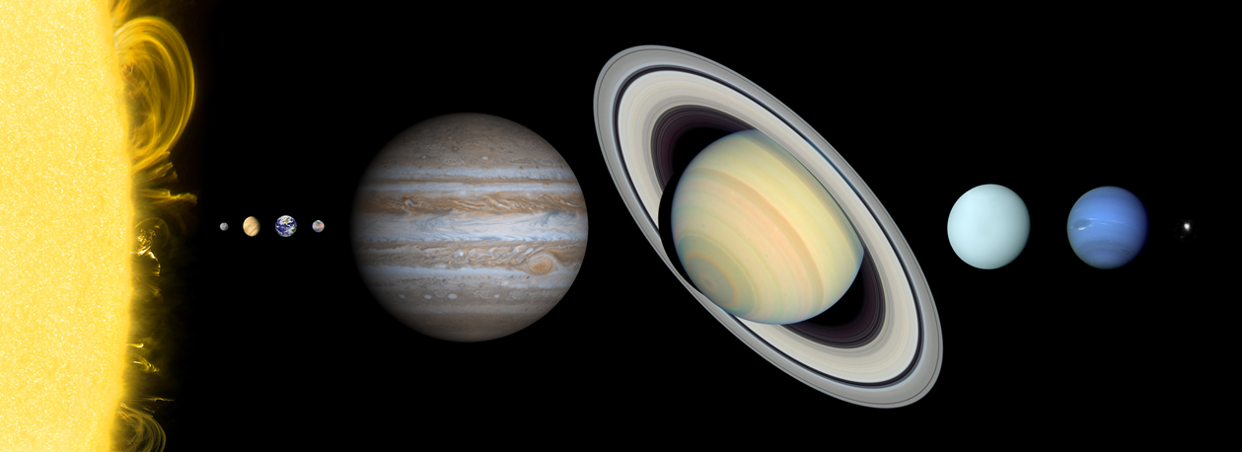
Notes:
Probes

Slide 61
On to Analysis…

Slide 62


Slide 63


Slide 64
Client <-> Server Errors
Automate the process of collecting Client and Server errors
Including Stack Traces from both systems
Paths to relevant Logs, ScreenShots, other test artifacts
Identifiable information to tie back to the Signature,
or the data used within the signature

Slide 65
Finding Interesting Outcomes
Levenshtein Distance
https://www.dotnetperls.com/levenshtein
“aunt” vs. “ant”, 1 distance
“Sam” vs. “Samantha”, 5 distance
“Flomax” vs. “volmax”, 3 distance
Even better, apply Levenshtein Distance as a percentage based comparison:
http://stackoverflow.com/questions/2344320/comparing-strings-with-tolerance/3160026
“CalculateSimilarity”

Slide 66
Improving Levenshtein Distance Accuracy
Remove “Test” information from Error Messaging and Stack Traces string
NameSpace
TestClass Name
TestMethod Name
User Names, Machine Names
Apply algorithm to Error Messages and Stack Traces as a percentage tolerance (minimum of 90%) to consolidate similar issues together.
Create efficient data structure to compare distances.

Slide 67
Test ID | Error Message | Calculated Distances
 |  | A | B | C | D | E | F
A | Assert.AreEqual failed. Expected:<OK>. Actual:<Bad Request>. Invalid status code returned: 400. | X | 10 | 0 | 79 | 0 | 0
B | Assert.AreEqual failed. Expected:<OK>. Actual:<Not Found>. Invalid status code returned: 404. | X | X | 10 | 79 | 10 | 10
C | Assert.AreEqual failed. Expected:<OK>. Actual:<Bad Request>. Invalid status code returned: 400. | X | X | X | 79 | 0 | 0
D | Page Timeout Exceeded. Script stalled on "http://testenvironment.com/StreetInformation" | X | X | X | X | 79 | 79
E | Assert.AreEqual failed. Expected:<OK>. Actual:<Bad Request>. Invalid status code returned: 400. | X | X | X | X | X | 0
F | Assert.AreEqual failed. Expected:<OK>. Actual:<Bad Request>. Invalid status code returned: 400. | X | X | X | X | X | X

Slide 68
Test ID | Error Message | Calculated Distances
 |  | A | B | C | D | E | F
A | Assert.AreEqual failed. Expected:<OK>. Actual:<Bad Request>. Invalid status code returned: 400. | X | 10 | 0 | 79 | 0 | 0
B | Assert.AreEqual failed. Expected:<OK>. Actual:<Not Found>. Invalid status code returned: 404. | X | X | 10 | 79 | 10 | 10
C | Assert.AreEqual failed. Expected:<OK>. Actual:<Bad Request>. Invalid status code returned: 400. | X | X | X | 79 | 0 | 0
D | Page Timeout Exceeded. Script stalled on "http://testenvironment.com/StreetInformation" | X | X | X | X | 79 | 79
E | Assert.AreEqual failed. Expected:<OK>. Actual:<Bad Request>. Invalid status code returned: 400. | X | X | X | X | X | 0
F | Assert.AreEqual failed. Expected:<OK>. Actual:<Bad Request>. Invalid status code returned: 400. | X | X | X | X | X | X
Test ID | Error Message | Calculated Distances (Pct Similarity)
 |  | A | B | C | D | E | F
A | Assert.AreEqual failed. Expected:<OK>. Actual:<Bad Request>. Invalid status code returned: 400. | X | 89% | 100% | 16% | 100% | 100%
B | Assert.AreEqual failed. Expected:<OK>. Actual:<Not Found>. Invalid status code returned: 404. | X | X | 89% | 16% | 89% | 89%
C | Assert.AreEqual failed. Expected:<OK>. Actual:<Bad Request>. Invalid status code returned: 400. | X | X | X | 16% | 100% | 100%
D | Page Timeout Exceeded. Script stalled on "http://testenvironment.com/StreetInformation" | X | X | X | X | 16% | 16%
E | Assert.AreEqual failed. Expected:<OK>. Actual:<Bad Request>. Invalid status code returned: 400. | X | X | X | X | X | 100%
F | Assert.AreEqual failed. Expected:<OK>. Actual:<Bad Request>. Invalid status code returned: 400. | X | X | X | X | X | X

Slide 69
Test ID | Error Message | Calculated Distances (Pct Similarity)
 |  | A | B | C | D | E | F
A | Assert.AreEqual failed. Expected:<OK>. Actual:<Bad Request>. Invalid status code returned: 400. | X | 89% | 100% | 16% | 100% | 100%
B | Assert.AreEqual failed. Expected:<OK>. Actual:<Not Found>. Invalid status code returned: 404. | X | X | 89% | 16% | 89% | 89%
C | Assert.AreEqual failed. Expected:<OK>. Actual:<Bad Request>. Invalid status code returned: 400. | X | X | X | 16% | 100% | 100%
D | Page Timeout Exceeded. Script stalled on "http://testenvironment.com/StreetInformation" | X | X | X | X | 16% | 16%
E | Assert.AreEqual failed. Expected:<OK>. Actual:<Bad Request>. Invalid status code returned: 400. | X | X | X | X | X | 100%
F | Assert.AreEqual failed. Expected:<OK>. Actual:<Bad Request>. Invalid status code returned: 400. | X | X | X | X | X | X
By applying a 90% threshold, we have successfully filtered the “400” errors from the “404”.
Assert.AreEqual failed. Expected:<OK>. Actual:<Bad Request>. Invalid status code returned: 400. | A
 | C | 100%
 | E | 100%
 | F | 100%
Assert.AreEqual failed. Expected:<OK>. Actual:<Not Found>. Invalid status code returned: 404. | B
Page Timeout Exceeded. Script stalled on "http://testenvironment.com/StreetInformation" | D

Slide 70
Thank you! And have a great Code Mash!
PPT available at http://tinyurl.com/MattCodeMash2017
Twitter: @mattperrin
Looking to be challenged?
Jobs.progressive.com
Come get some swag!
Global Game Jam
globalgamejam.org
Worldwide Video Game Hackathon on January 20th – 22nd
Don’t forget your surveys in the Event XD app.
Any questions?

